Slide 1
Administration
Participation Reminders
Office Hours Tool
Forum Posts (Answering & Asking)
Thursday Office Hours 2-4pm, 5-6pm (moved)
Friday: WPI Wellness Day
No classes
No CS3013 office hours that day
Project 2 Takeaways
Partner evaluations
Realistic Design & Iteration Experience
Project 3 same schedule
Project 3: Checkpoint Next Tuesday

Slide 2
Project 3 Released
Checkpoint next Tuesday
Final Submission in 10 days
Virtual Memory & Paging Quick-Start (Project 3 Document)
The OSTEP textbook has highly relevant information for the project
Chapter 18 – Paging
Diagrams around pages …182-183…
Figure 18.3 "The Address Translation Process"
Shows mapping from VPN -> PFN (aka PPN)
Figure 18.4 "Example: Page Table in Kernel Physical Memory"
Figure 18.6 "Accessing Memory with Paging"
Good P3 pseudocode!

Slide 3
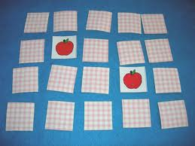
Memory Management
+ MBA?

Slide 4
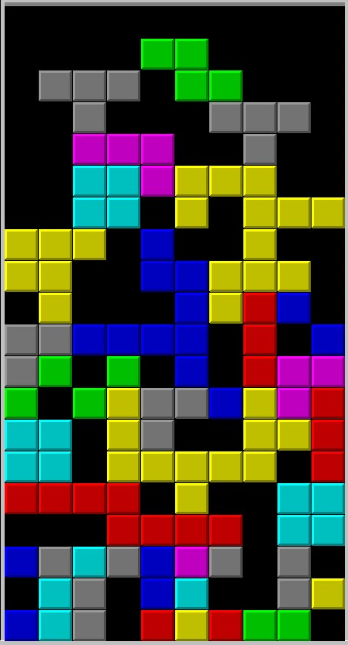
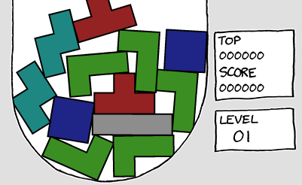
Memory Allocation Policies

Slide 5

Memory Allocation – Policies
Policy examples
First Fit: scan free list and allocate first hole that is large enough – fast
Next Fit: start search from end of last allocation
Best Fit: find smallest hole that is adequate – slower and lots of fragmentation
Worst fit: find largest hole
Simulation results show that First Fit usually works out to be the best

Slide 6
Swapping and Scheduling
Swapping
Move process from memory to disk (swap space)
Process is blocked or suspended
Move process from swap space to big enough partition
Process is ready
Set up Base and Limit registers
Memory Manager (MM) and Process scheduler work together
Scheduler keeps track of all processes
MM keeps track of memory
Scheduler marks processes as swap-able and notifies MM to swap in processes
Scheduler policy must account for swapping overhead
MM policy must account for need to have memory space for ready processes

Slide 7
Can we do better?

Slide 8
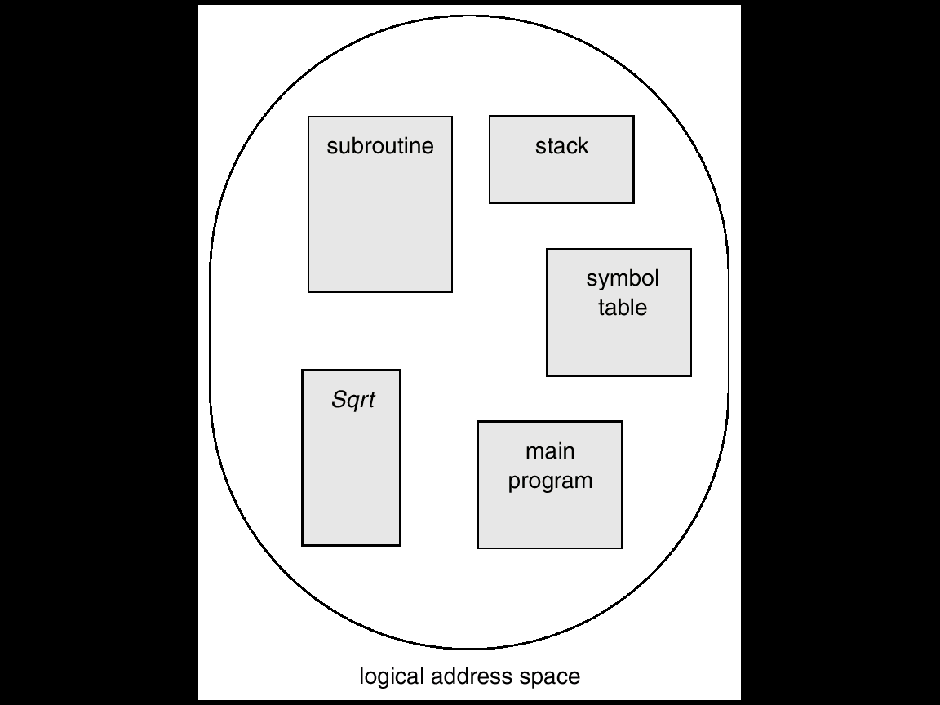
User’s View of a Program

Slide 9
Memory Management — Beyond Partitions
Can we improve memory utilization and performance?
Processes have distinct parts
Code – program and maybe shared libraries
Data – pre-allocated and heap
Stack
Solution – slightly more Memory Management hardware
Multiple sets of “base and limit” registers
Divide process into logical pieces called segments
Advantages of segments
Code segments can be grown – may require segment swap
With separate I don’t need to be swapped out and may be shared
Stack and heap and D spaces can have larger virtual address spaces
“I” = Instruction (i.e., code, always read-only)
“D” = Data (usually read-write)
Security?! Maybe that too…

Slide 10
Logical View of Segmentation
1
1
4
2
3
4
2
3
user space
physical memory space

Slide 11
Segmentation
Logical address consists of a pair:
<segment-number, offset>
Segment table – maps two-dimensional physical addresses; each table entry has:
Base: contains the starting physical address where the segments reside in memory.
Limit: specifies the length of the segment.

Slide 12
Segment Lookup
Index to segment register table
Segment registers
physical memory
limit
base
segment 0
segment #
offset
segment 1
virtual address
segment 2
<?
yes
+
segment 3
no
Physical
Address
raise
protection fault
segment 4

Slide 13
Segmentation
Protection. With each pair of segment registers, include:
validation bit = 0 ⇒ illegal segment
read/write/execute privileges
Protection bits associated with segments; code sharing occurs at segment level.
Since segments vary in length, memory allocation is a dynamic storage-allocation problem
With all the problems of fragmentation!

Slide 14
Segmentation
Common in early minicomputers
Small amount of additional hardware – 4 or 8 segments
Used effectively in classical Unix
Good idea that has persisted and supported in current hardware and OSs
Pentium, x86 supports segments
Linux supports segments (sort of)
Still have external fragmentation of memory
What is the next level of Memory Management improvement?
Next topic

Slide 15
Memory Management
Allocation of physical memory to processes
Virtual Address
Address space in which the process “thinks”
Each virtual address is translated “on the fly” to a physical address
Fragmentation
Internal fragmentation – unused within an allocation
External fragmentation – unused between allocations

Slide 16
Memory Management Review
Segmentation
Recognition of different parts of virtual address space
Different allocation strategies
The rule of “no free lunch”
Fixed size allocations ≡ no external fragmentation, more internal fragmentation
Variable allocations ≡ no internal fragmentation, more external fragmentation

Slide 17
Paging
A different approach
Addresses all of the issues of previous topic
Introduces new issues of its own

Slide 18
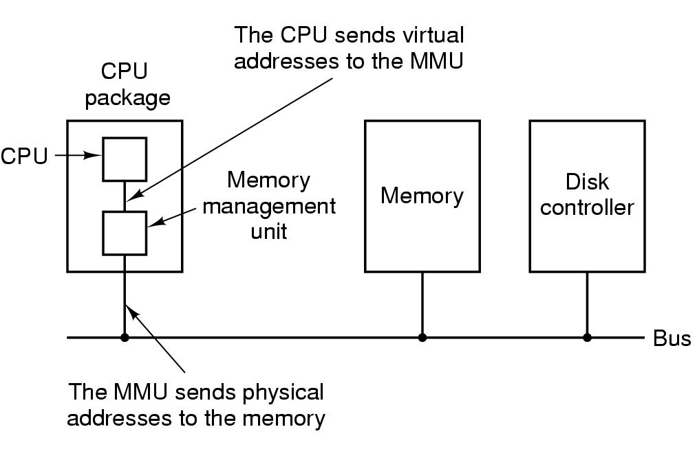
Virtual Memory – Paging (1)

Slide 19
Paging
Use small fixed size units in both physical and virtual memory
Provide sufficient MMU hardware to allow page units to be scattered across memory
Make it possible to leave infrequently used parts of virtual address space out of physical memory
Solve internal & external fragmentation problems
Logical Address Space (virtual memory)
physical memory
page 0
frame 0
page 1
frame 1
page 2
frame 2
page 3
MMU
…
…
frame Y
page X

Slide 20
Paging Translation
virtual address
virtual page #
offset
physical memory
page
frame 0
page table
page
frame 1
physical address
page
frame 2
page frame #
F(PFN)
offset
page
frame 3
…
page
frame Y

Slide 21
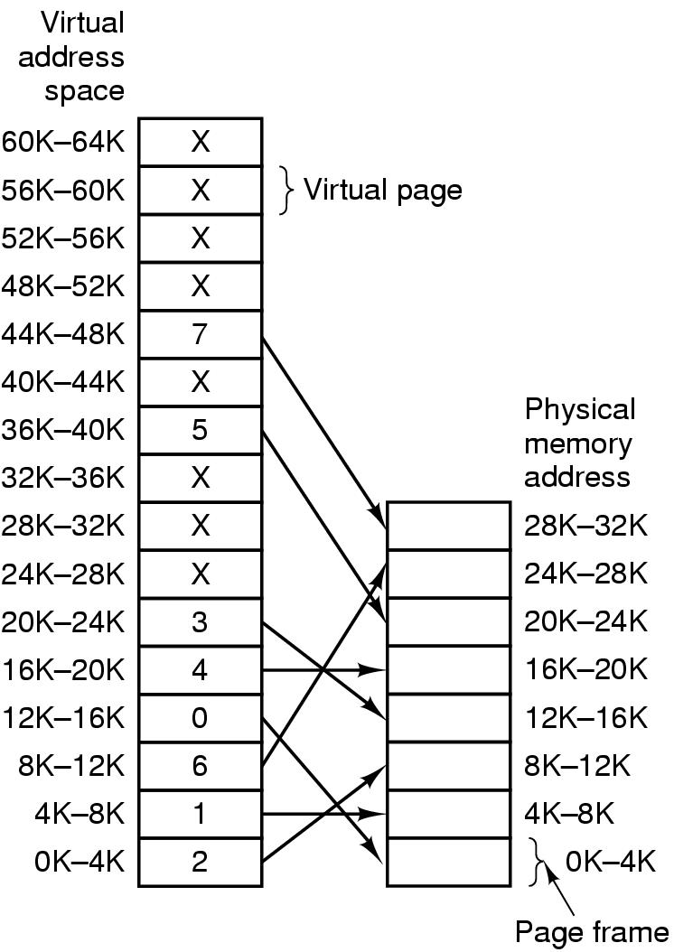
Paging

Slide 22
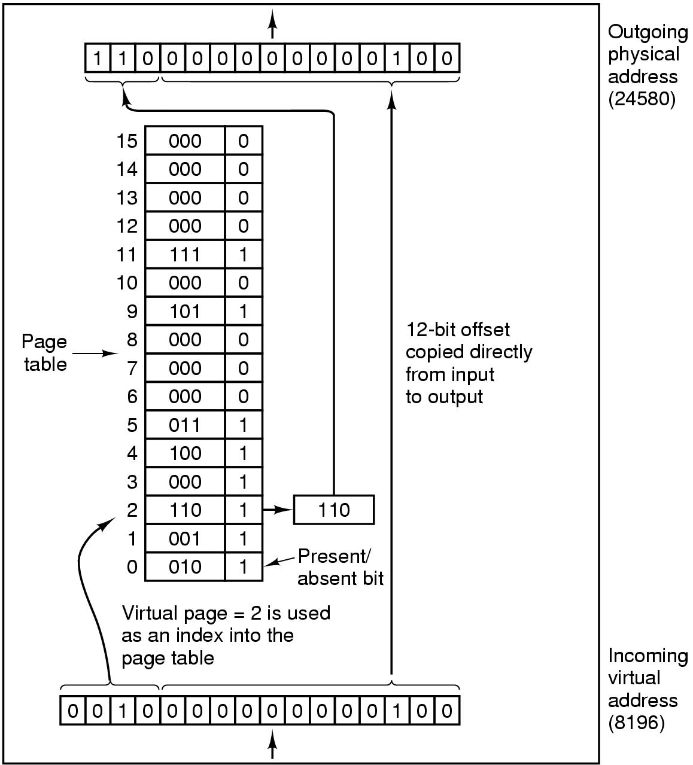
Paging

Slide 23
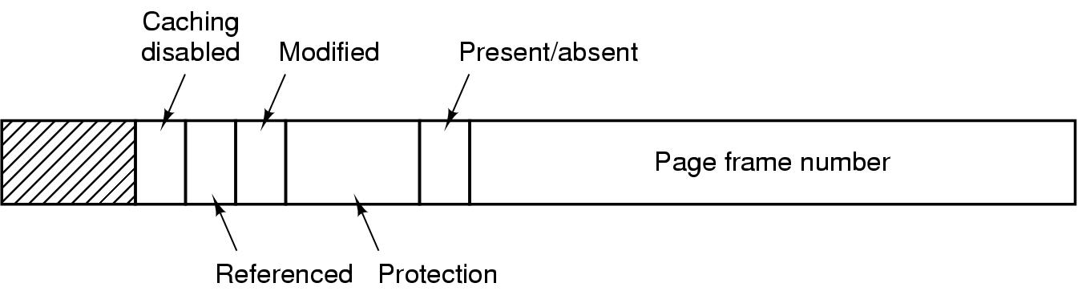
Structure of Page Table Entry

Slide 24
Paging – Advantages
Easy to allocate physical memory
pick (almost) any free frame
No external fragmentation
All frames are equal
Minimal internal fragmentation
Bounded by page/frame size
Easy to swap out pages (called pageout)
Processes can run with not all pages swapped in

Slide 25

Slumlord Shue’s Apartments

Slide 26
Definition — Page Fault
Trap when virtual address has valid bit=0 in page table
If page exists on disk:
Suspend process
Possibly evict another page (and update its PTE)
Swap in desired page, resume execution
If page does not exist on disk:
Return program error
Conjure up a new page and resume execution
Example: growing the stack

Slide 27
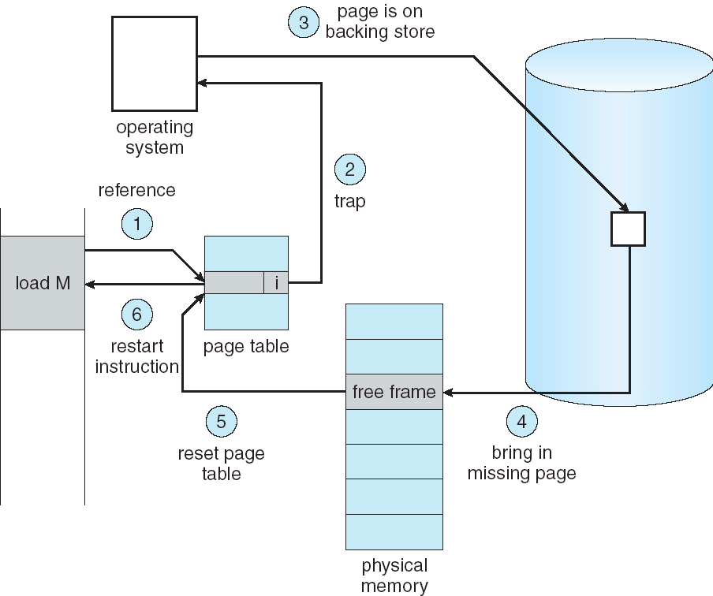
Steps in Handling a Page Fault

Slide 28
Definition — Backing Storage
A place on external storage medium where copies of virtual pages are kept
Usually a hard disk (locally or on a server)
Place from which contents of pages are read after page faults
Place where contents of pages are written if page frames need to be re-allocated

Slide 29
Discussion Questions
What are the hardware consequences of segmentation? Are they a big deal?
What is the likely practical impact of segmentation verses partitions? Do the smaller segments really help that much?
Are protection bits redundant? If a region is supposed to be read-only, couldn’t a process just, you know, not write to it?

Slide 30

The End is Near

